Slide 1
GIP presentation
The pinball machine by Robin monsere

Slide 2
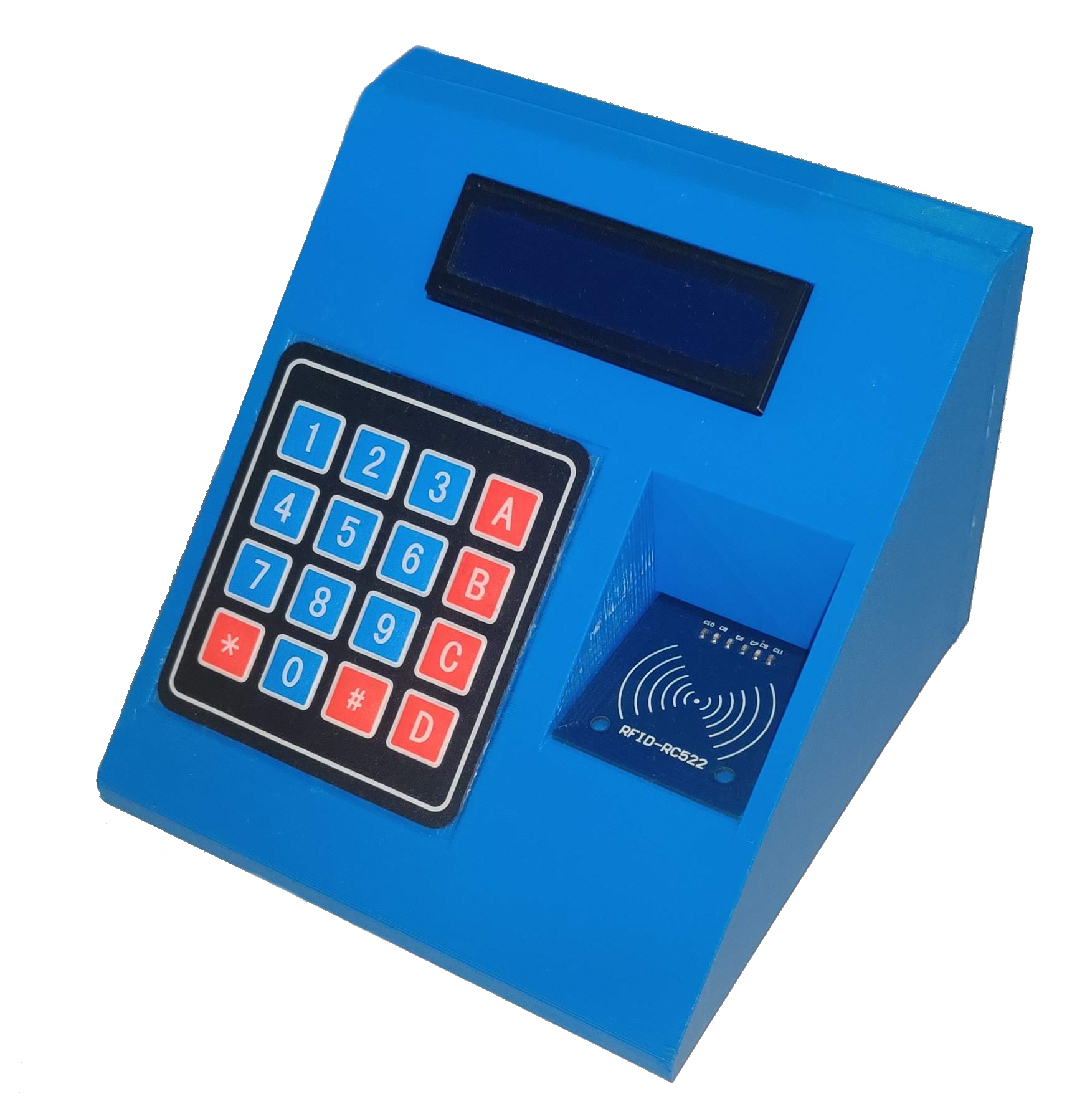
2 parts

Slide 3
No external partner/company

Slide 4
Why a pinball machine?
Had a lot of ideas
Has electronics/software/hardware
Wanted to learn RFID

Slide 5
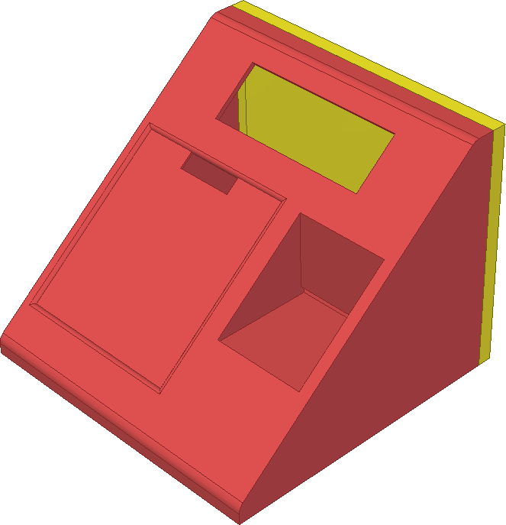
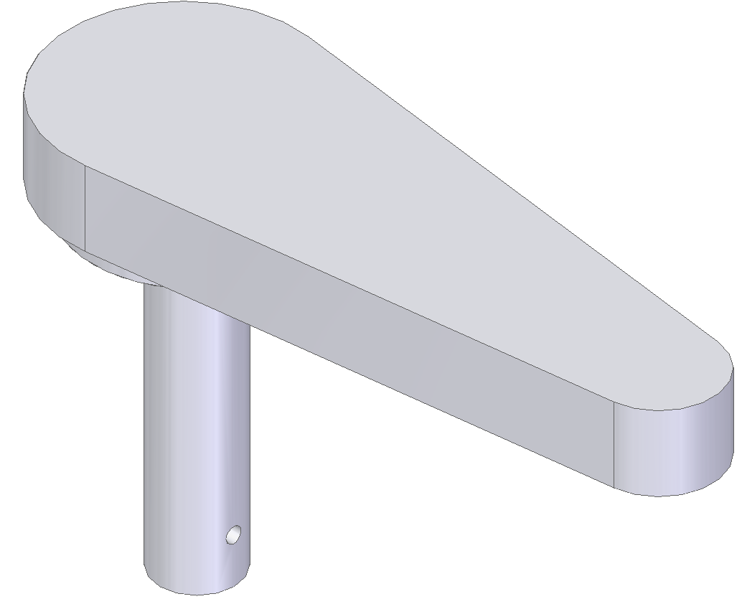
How? – 3D printing
Sketches
3D drawing
Printing

Slide 6

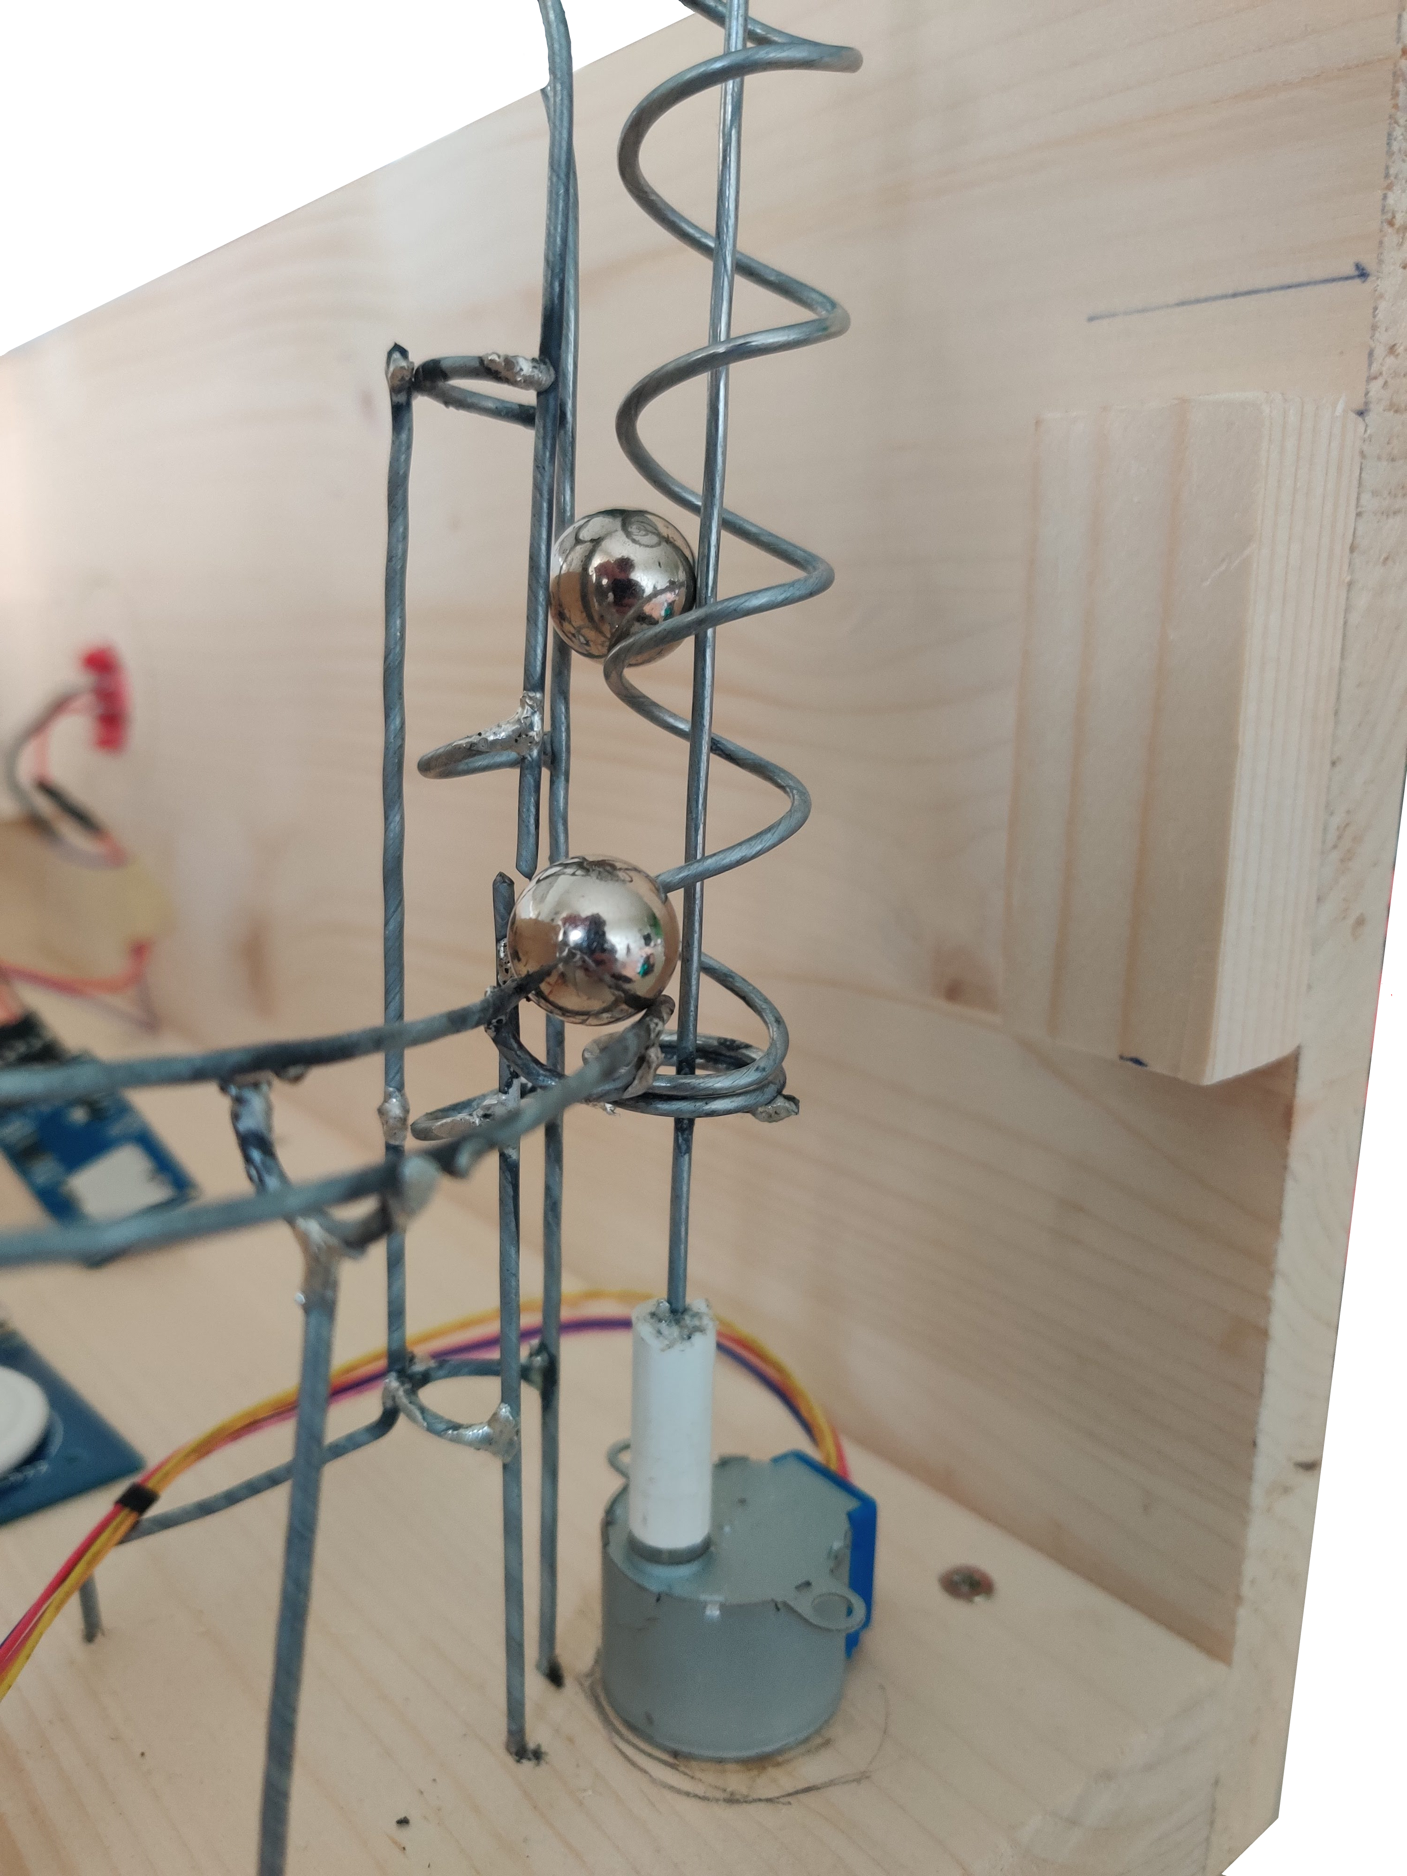
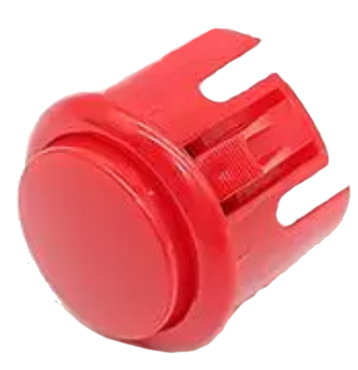
How? – pinball machine
Wood
Marble tracks
Solanoids

Slide 7
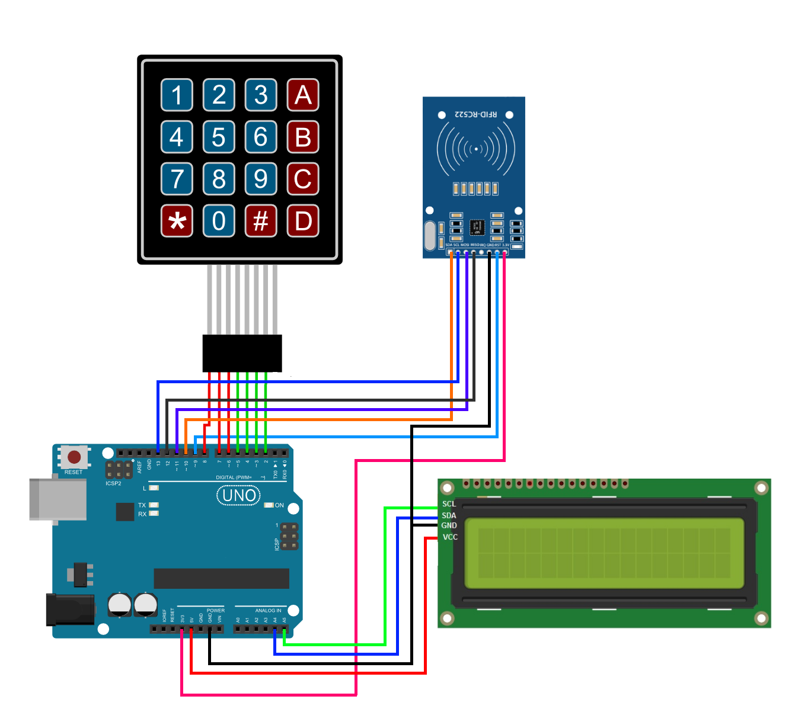
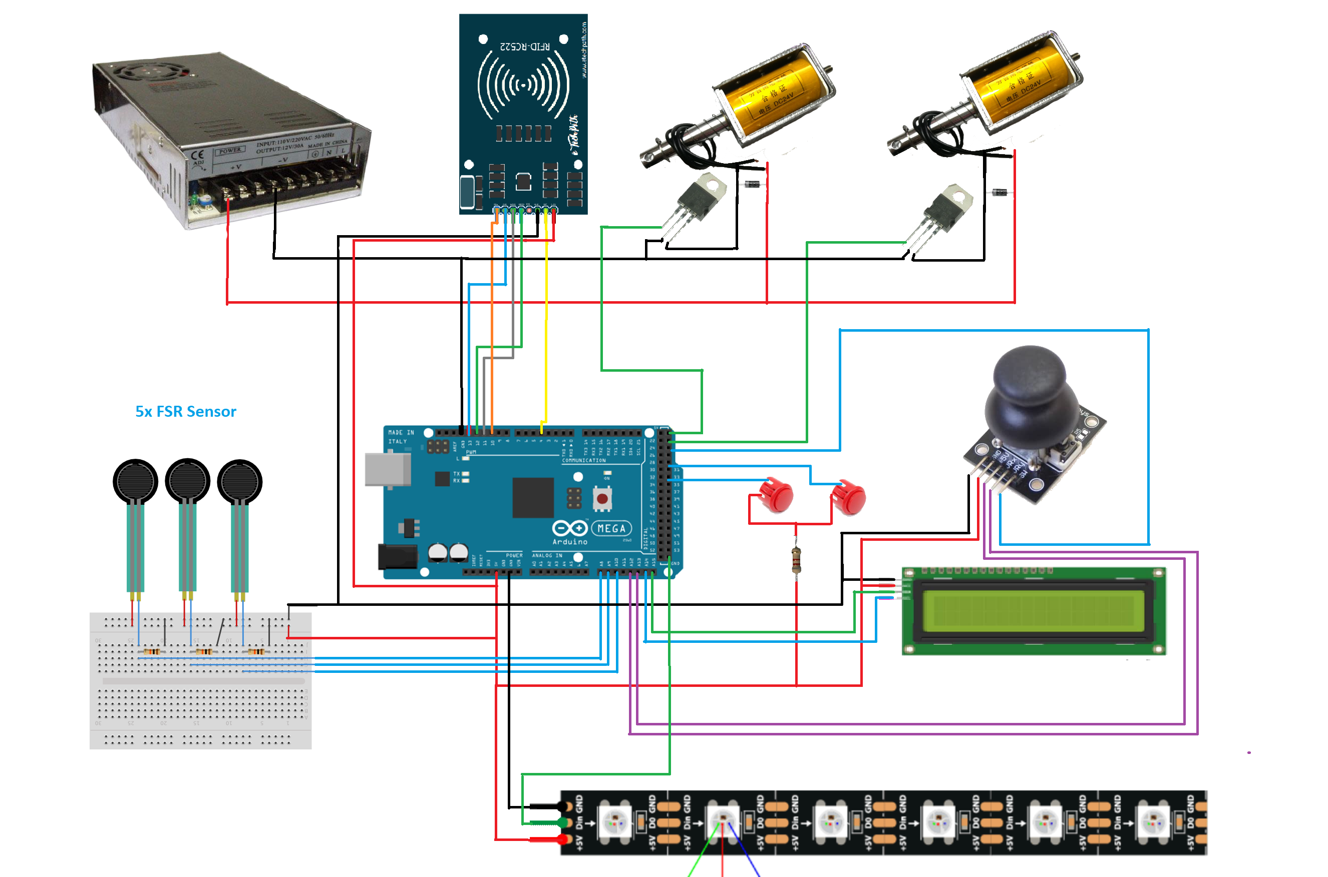
How? – Electronics
Sketches
Connect and test
soldering

